Slide 1
607 week13 nosql –neo4j
Jun Pan submission

Slide 2
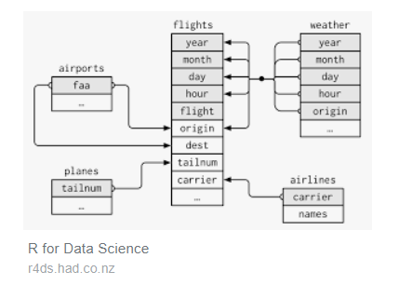
Relational database of flights13

Slide 3
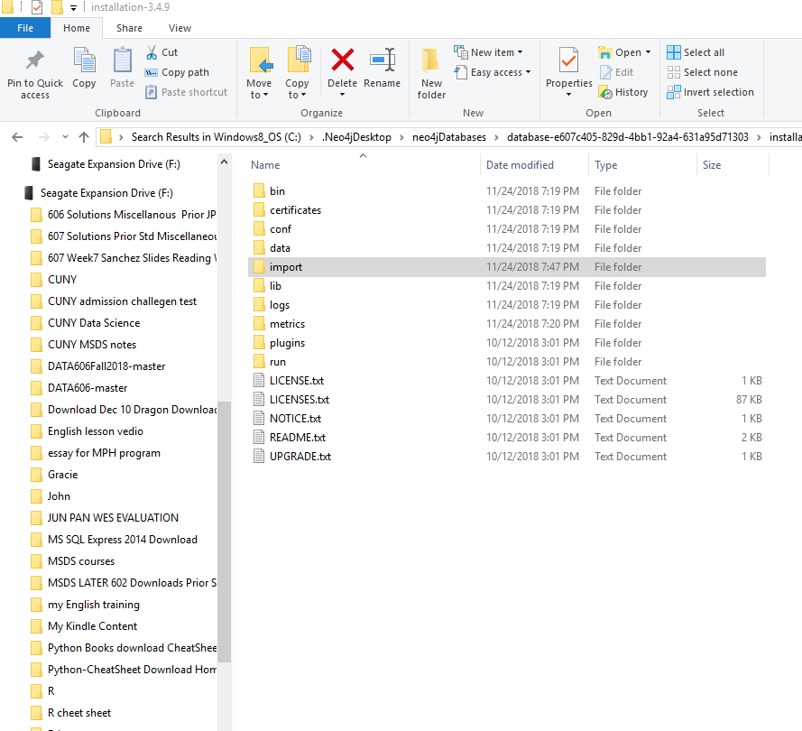
After I exported into csv files from R and installed Neo4J, I created a import folder under Neo4j and dragged the csv files into it.

Slide 4
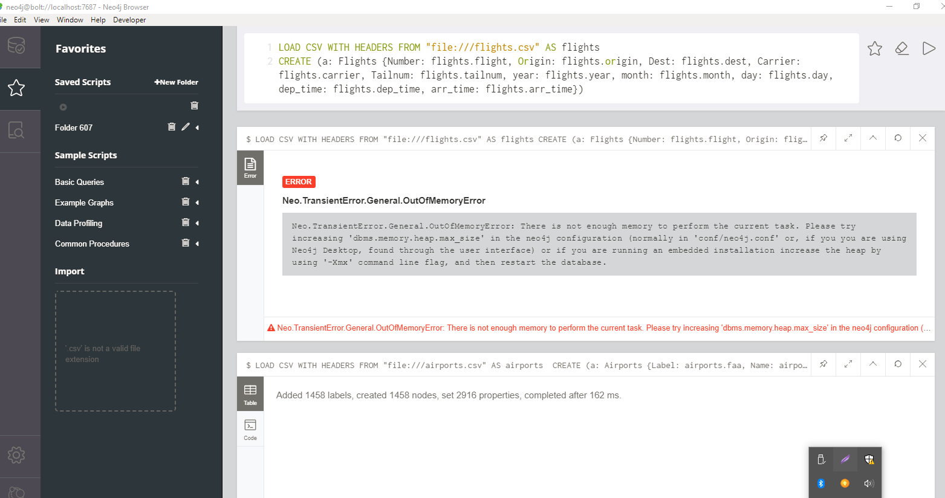
The original files were too big for my computer’s memories, so I had to reduce the size of it.

Slide 5
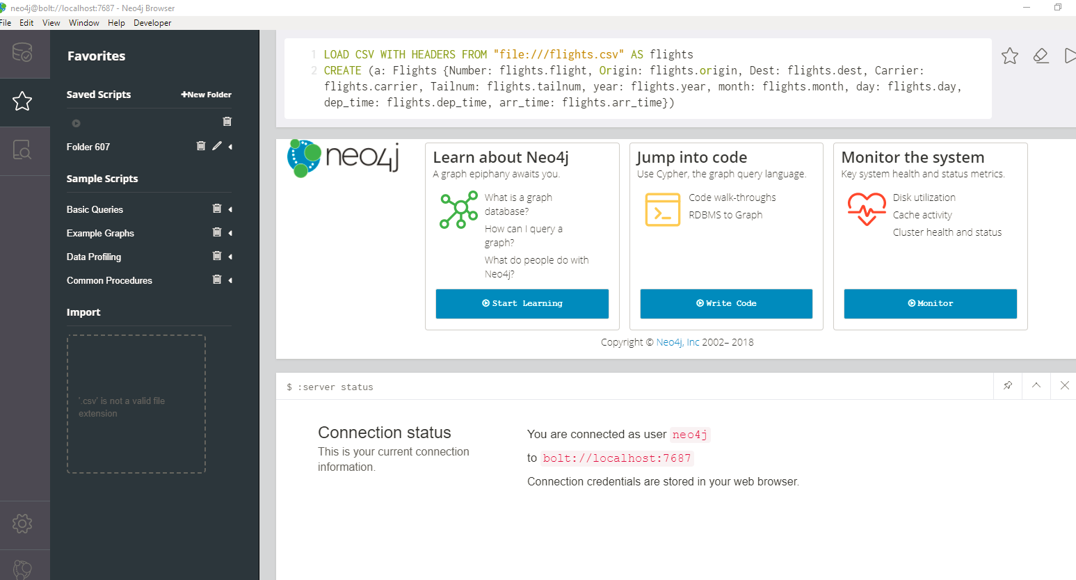
After reduced the size of flights file, everything was fine. Other four files are small, we did not have any problem.

Slide 6
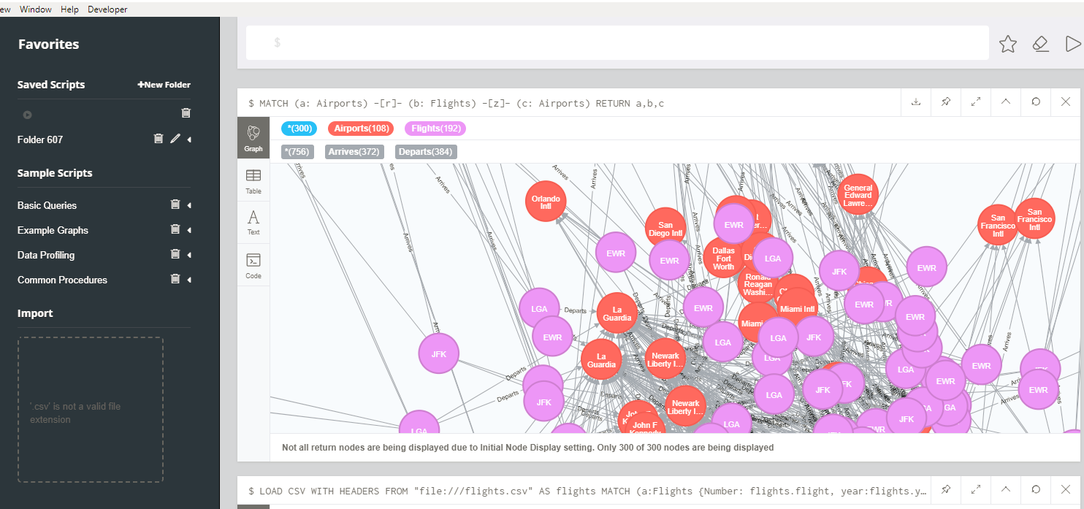
This is the nodes which I had created

